Slide 1
CATALOGING PRINCIPLES AND THEIR APPLICATION: DEEP FOCUS
Tuesday, October 25, 2:30 – 5:30
Presented by Nancy Goldman at
Albanian Cinema Project
Archives in Motion (AIM) Workshops
Notes:
What I will cover today is more the nitty-gritty of cataloging; what goes into a record; how you decide how to organize the information and where it goes in a record (we’ll focus on using FIAF rules and EN15907 structure, but the same concepts could be used for any record); and different cataloging levels.

Slide 2
What is FRBR
Functional Requirements for Bibliographic Records
Entity-relationship conceptual model
Describes relationships of records to each other, not just displaying them as a collective list
Available at http://www.ifla.org/en/publications/functional-requirements-for-bibliographic-records.
Notes:
I want to start by discussing conceptual data models and structures that support the FIAF cataloguing guidelines that we will be discussing later; in particular FRBR, or Functional Requirements for Bibliographic Records, and the European CEN standards.
FRBR is a project of the International Federation of Library Associations and Institutions. It was written during the 1990s to help libraries and archives move cataloging from static flat file systems to more relational data models.
The idea behind the FRBR entity-relationship conceptual model is that the catalog is not seen as a sequence of records, but rather as a network of connected data. FRBR clarifies how catalogs should function, and illuminates what information is of the most value to users of the catalog.

Slide 3
FRBR’s 3 Entities
Group 1 – products that are named or described in the bibliographic record
work, expression, manifestation, item
Group 2 – entities responsible for physical production and dissemination, or the custodianship of such products
person, families, corporate bodies
Group 3 – entities that serve as the subjects of intellectual or artistic endeavor
concept, object, event, place
Notes:
FRBR is divided into three different entities, with Group 1 receiving the most attention. The Group 2 entities can be thought of as “agents” responsible for the existence of Group 1 products, and Group 3 concerns subjects.

Slide 4
FRBR GROUP 1 ENTITIES
Work
A distinct intellectual or artistic creation
Expression
The intellectual or artistic realization of a work
Manifestation
The physical embodiment of an expression of a work
Item
A single example of a manifestation
Notes:
In the development of new tools such as RDA and particularly EN 15907, there has been a lot of discussion on how to represent the four group 1 entities: work, expression, manifestation, and item. Although they work relatively well for bibliographic texts, they aren’t as easy to implement for other formats such as moving images. So various groups have come up with different interpretations. For example, the Online Audiovisual Catalogers group (http://www.olacinc.org) developed a report on moving image works that describes a concept of “Work Primary Expression” which is usually a film’s original release version. In my opinion one of the important concepts to remember about FRBR is that it is CONCEPTUAL – different user groups may interpret the four entities differently. I sometimes think of it like a ladder; depending on what type of institution you are cataloging for you may describe the levels differently. For example, a general library may want to describe the original Shakespeare play “Hamlet” at the work level, while an archive that only has moving image works might start with a particular variant. But for today’s talk, I will describe the general way I think FRBR is interpreted.

Slide 5
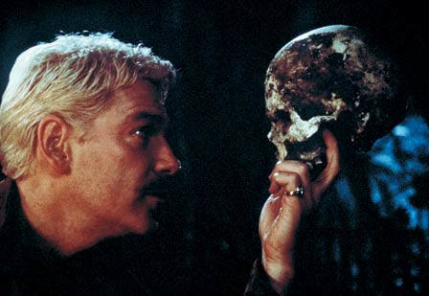
EXAMPLE
WORK: Hamlet
EXPRESSION: Branagh’s Hamlet
MANIFESTATION: 35mm print
ITEM: Specific 35mm print in archive collection
Notes:
The way I interpret the general FRBR entities is as in the above example, where the work would be the first creation – in this case, the play by Shakespeare, and expressions might include various filmed versions, such as the one by Branagh, as well as published copies of the play, a videotape of a performance, etc. Both works and expressions are ideas, not physical items. The terms manifestation and item refer to the physical (or digital) instantiations, for example a 35 print, a DVD etc., and item references a specific manifestation, such as a particular archive’s copy.
However, an archive may not need to reference the top level – in this case the play by Shakespeare, but may instead choose to use the Expression level or the Work primary expression concept to document variants of a particular film.

Slide 6
WHAT IS A WORK
See
http://kcoyle.blogspot.com/2009/08/what-is-frbr-work.html
www.olacinc.org
and
http://www.olacinc.org/drupal/?q=node/359
for interesting discussions on defining FRBR works
Notes:
There has been much discussion of how the FRBR entities are defined in film cataloging. Librarian Karen Coyle has several interesting posts on the topic on her blog – one of them is at http://kcoyle.blogspot.com/2009/08/what-is-frbr-work.html.

Slide 7
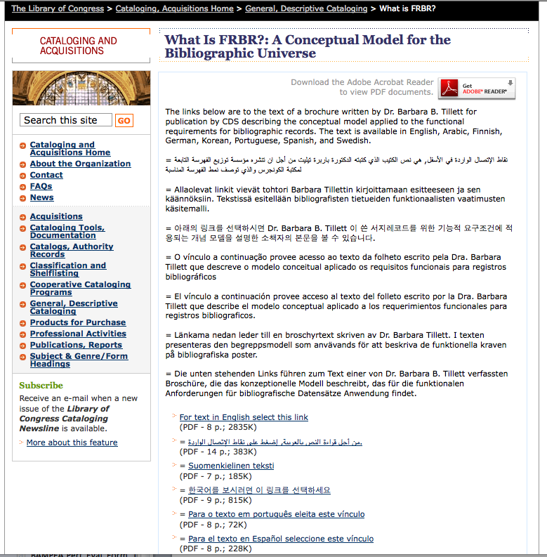
Notes:
Barbara Tillett of the Library of Congress wrote an excellent brochure that describes the FRBR model; it has been translated into a number of languages.

Slide 8
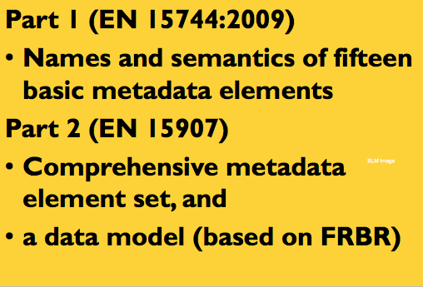
European Committee for Standardization (CEN)
Notes:
As I mentioned, the European Union has developed two standards meant to improve interoperability of film metadata. FIAF based a lot of the concepts in its new manual on the CEN work. In 2005, the EU Commission, which is the executive body of the European Union, issued a mandate to create a common metadata specification for the identification of cinematographic works. This work was delegated to the European Committee for Standardization (CEN). CEN members come from the national standards bodies of 30 countries.
The CEN Technical Committee 372, for Cinematographic Works, which is made up of film archivists, software engineers and IT specialists, created a two-part standard.
Part 1 (EN 15744:2009)
Defines names and semantics of fifteen basic metadata elements
Part 2 (EN 15907)
Provides a comprehensive metadata element set, and a data model (based on FRBR)
Together they are called the CEN Cinematographic Works Standard, or CEN CWS.
We expect that many archives using this metadata schema will use it in concert with the FIAF Moving Image Cataloguing Manual.

Slide 9
CEN Metadata List – EN 15944
Defines:
Title
Series
Cast
Credits
Production Company
Country of reference
Original format
Original length
Original duration
Original language
Year of reference
Identifier
Genre
Relationship
Source
Notes:
I have reproduced here the minimum list of metadata defined in the first standard, EN 15944. The second standard, EN 15907, is a much more detailed schema based on a FRBR-like model. The website filmstandards.org has a lot of information on these schema.
The European Film Gateway’s fields are in part based on this list.

Slide 10
CEN Metadata List: Part 2 – EN 15907
Primary Entities
Cinematographic Work
Variant
Manifestation
Item
Content (subject of work)
Contextual Entities
Agent
Event
Relationships
hasAgent
hasEvent
hasContent
hasAsSubject
hasAsOtherRelation
hasVariant
hasManifestation
hasItem
Notes:
Part 2 goes into much more detail, providing a data model based on FRBR entities from all three groups and their relationships. Again, I’m not going to go into detail here, but you can find extensive information on the standards on the CEN website, as well as on the filmstandards.org website which was developed by Detlev Balzer, one of the primary developers of the standard.

Slide 11
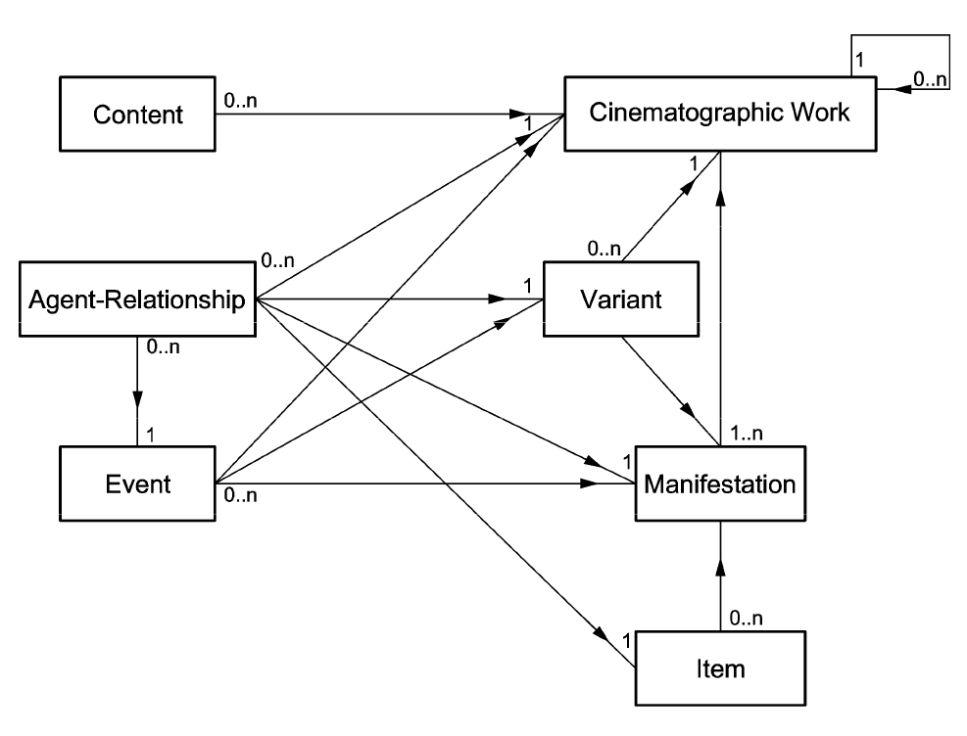
EN 15907 data model
Notes:
Here is a slide from filmstandards.org showing the EN15907 data model, which indicates the relationships between the entities. One of the major differences between the CEN and FRBR interpretations is the definition of a work, and CEN’s use of the concept of “variant” instead of “expression.”

Slide 12
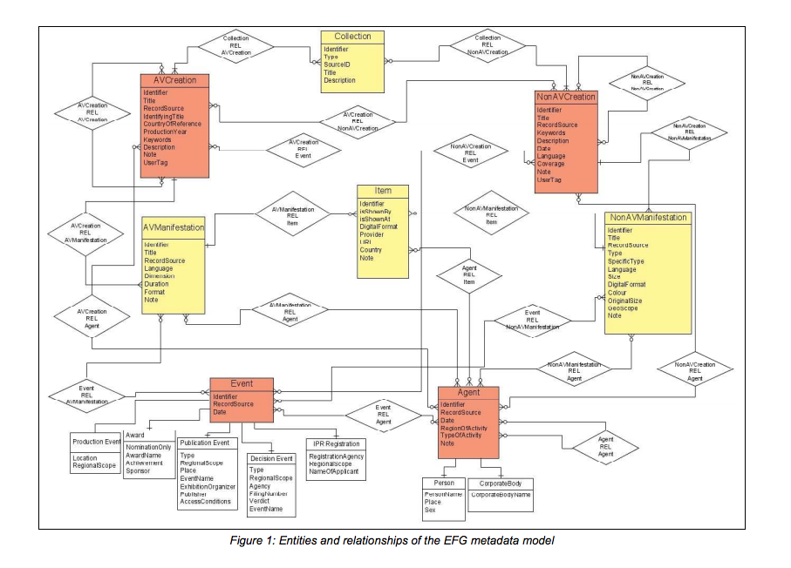
Notes:
Here is the EFG model which has 8 entities. It is described in great detail at
http://efgproject.eu/guidelines_and_standards.php

Slide 13
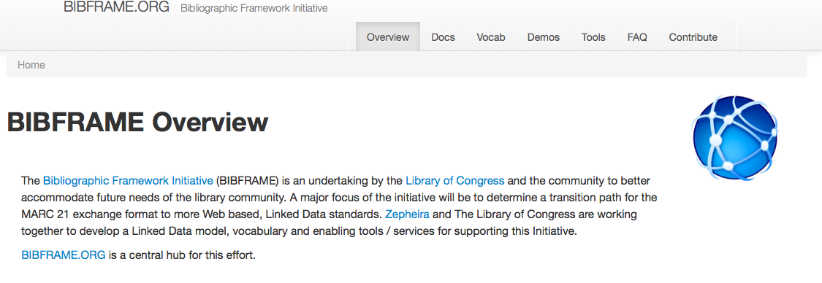
BIBFRAME
Notes:
Another initiative that promises to revolutionize cataloging is the Bibliographic Framework Initiative, or BIBFRAME. It is an initiative to to “determine a transition path for the MARC 21 exchange format to more Web based, Linked Data standards. Zepheira and The Library of Congress are working together to develop a Linked Data model, vocabulary and enabling tools / services for supporting this Initiative.

Slide 14
Standards
TYPE | DEFINITION | EXAMPLE
Content | How descriptive data is expressed; often referred to as rules or best practices guidelines | AMIM2, DACS, CCO, RAD, AACR2R (RDA), Chicago Manual of Style, FIAF
Value (Authorities) | How descriptive data is controlled; often referred to as access points | LCNAF, LCSH, AAT, MIGFG, MIM, TGM, ULAN, SMPTE RP224
Field or Structure | Specification of the elements of description and their relationships to each other; often referred to as a schema | MARC/ISBD (also content/display standard), MODS, Dublin Core, PBCore, IEEE-LOM, MPEG-7, EAD, EN15907
Format | How description is formatted and transmitted; also referred to as a communication format or framework standard | MARC/ISO2709, XML, RDF
Notes:
Last week I described the types of cataloging standards – data content, data value, data structure, and data format.

Slide 15
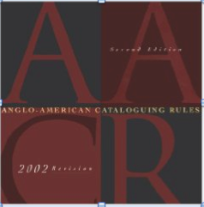

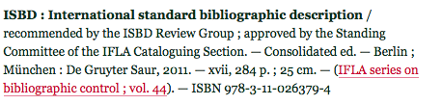
Content Standards
GENERAL
Anglo-American Cataloging Rules, Second Edition, Revised (AACR2r)
Resource Description and Access (RDA)
International Standard Bibliographic Description (ISBD)
Notes:
I’ll now describe a few of these standards in more detail, including ones used in general libraries and archives as well as ones used in moving image archives.
Two general content standards that were widely used in many institutions for decades are AACR and ISBD. The last revision of AACR was AACR2r. Its successor RDA has now been adopted by many libraries.

Slide 16
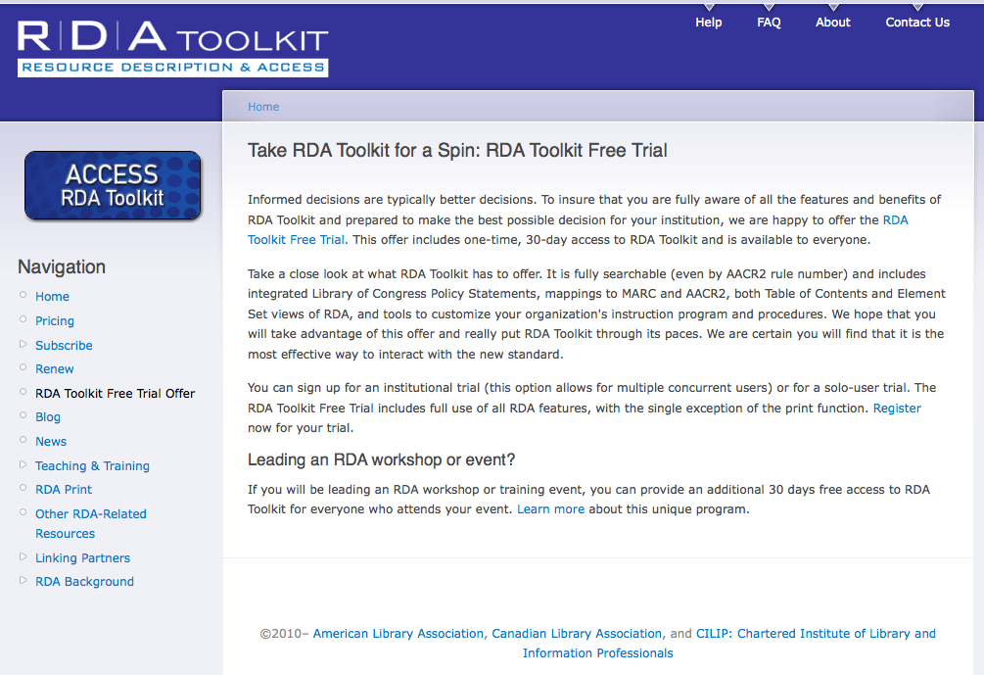
RDA Toolkit http://www.rdatoolkit.org/trial
Notes:
The RDA toolkit is available by subscription, and they are offering a 30 day free trial as well; go to the website listed above for more information.

Slide 17
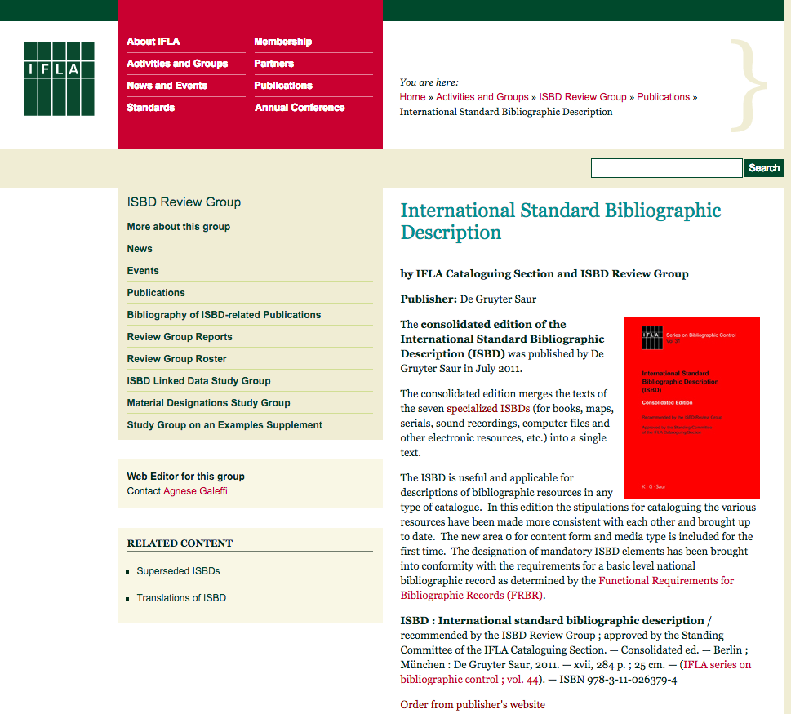
ISBD
Notes:
One other general standard, used widely in Europe, is the International Standard Bibliographic Description (ISBD). It originated in 1969 out of the International Meeting of Cataloging Experts who determined that a standardization of the form and content of bibliographic description must be established. It is maintained by the International Federation of Library Associations and Institutions (IFLA).
In 2011, the ISBD consolidated its seven specialized ISBDs (for books, maps, serials, sound recordings, computer files and other electronic resources) into a single text, cited above.

Slide 18
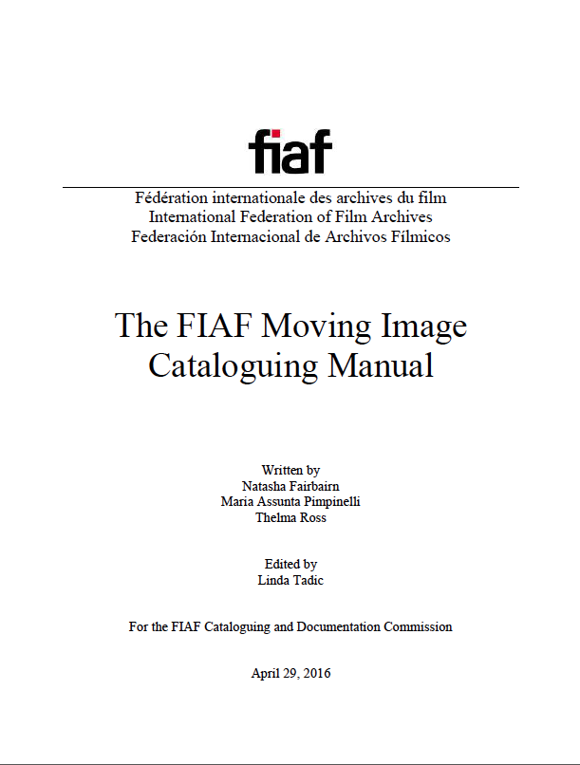
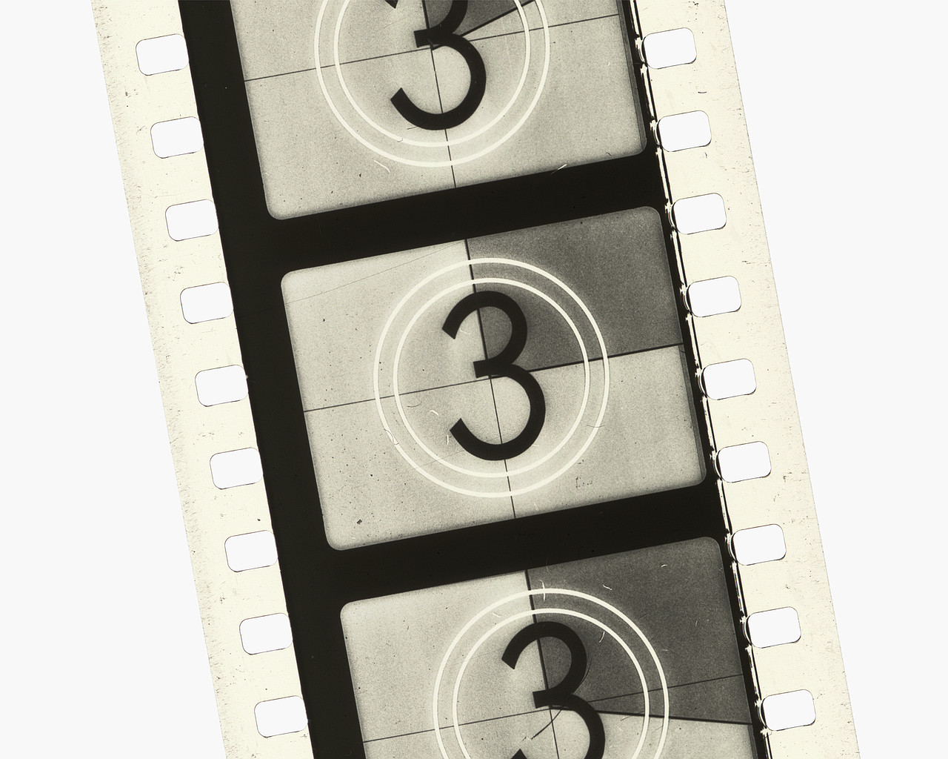
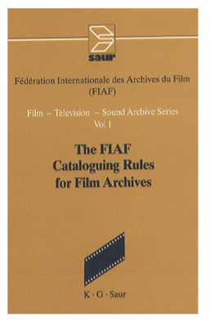
CONTENT STANDARDS: Moving Image Specific
Archival
Moving Image
Materials
A cataloguing
Manual
Second Edition
2000
1991
Notes:
I’ll now describe moving image specific content standards: AMIM2 and FIAF Cataloguing Rules.
For a long time, the two most heavily used moving image specific data content standards are The FIAF Cataloguing Rules for Film Archives and Archival Moving Image Materials (AMIM). Both of these content standards drew from ISBD and the Anglo American Cataloguing Rules. The 1991 FIAF Rules have recently been superseded by the FIAF Moving Image Cataloguing Manual, which is available as a PDF download from the FIAF website. It is also available in a hard copy format.

Slide 19
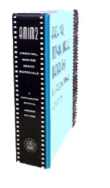
AMIM2
Archival Moving Image Materials: a cataloging manual. 2nd edition. The AMIM Revision Committee, Motion Picture, Broadcasting and Recorded Sound Division. Washington: Library of Congress, 2000.
Notes:
The first edition,of Archival Moving Image Materials (AMIM), written by Wendy White-Hensen, was published by the Motion Picture, Broadcasting and Recorded Sound Division of the Library of Congress in 1984. It was extensively revised by LoC in the late 1990s with major input from members of the Cataloging Committee of the Association of Moving Image Archivists and the second edition was published in 2000. AMIM and AMIM2 were written to adapt the special requirements for describing archival materials to existing national and international standards such as AACR2 and ISBD. They supplement and expand the rules in AACR2 to make the resulting catalog records more useful to an archive; particularly in areas such as describing multiple parts, listing multiple physical descriptions, handling edition/version issues; listing variant titles (how and where to include both the original and English-language titles on a record for a foreign film that is subtitled in English); and the importance of research beyond the chief source of information (the item itself). These differences make it easier for archives to catalog multiple elements and releases in one record rather than having to create separate records for each manifestation, as is the case with most other media, such as books. For most other types of materials, the cataloging data is primarily taken from the item itself, such as the title page of a book or journal. Thus the item itself is the chief source of information. This doesn't always work for moving images, where often you have to go to secondary sources for information. For example, not all credits appear on a film –they may only appear in press kits or other secondary sources. And a cataloger may not always be able to view the entire film to find and transcribe all data; instead they may use write-ups from other sources – press kits, reviews, catalogs such as the AFI Catalog, distribution catalogs, or others. AMIM diverges from AACR2 in four major ways: filmographic data for the original manifestation of the work is used as the basis for cataloging subsequent manifestations; multiple lines of physical description are used; rereleases and reissues are combined on the same record with original manifestation; and preferred source of information used instead of chief source of information.
Although I think it still offers many interesting concepts in cataloging moving images, it is used much less as moving image catalogers move to new resources such as RDA, the new FIAF manual, and future developments. But I like to introduce it to give you a sense of the history of moving image cataloging and specific rule sets. And in fact it is still used to catalog older formats at the Library of Congress Motion Picture, Broadcasting, and Recorded Sound division.

Slide 20
FIAF
FIAF Cataloging Rules for Film Archives. / Fédération Internationale des Archives du Film. Compiled and edited by Harriet W. Harrison for the FIAF Cataloguing Commission. Munich; London; New York; Paris: G.K. Saur, 1991.
The FIAF Moving Image Cataloguing Manual / Fédération Internationale des archives du film. Written by Natasha Fairbairn, Maria Assunta Pimpinelli, and Thelma Ross; edited by Linda Tadic for the FIAF Cataloguing and Documentation Commission. Brussels, Belgium: FIAF, 2016
Notes:
The former FIAF Cataloguing Rules were written by Harriet Harrison and the FIAF Cataloging Commission in 1991 and are geared to users in many countries. They have much in common with AMIM, but with some differences in placement of data. One of the main differences between FIAF and AMIM rules concerns using original title in country of origin and original production information on records for all subsequent manifestations of a work; this is in fact in line with current FRBR (Functional Requirements for Bibliographic Records) design, which is also incorporated into RDA. The FIAF Cataloguing and Documentation Commission recently finished a decade-long project to revise the cataloging rules. The revision was led by Thelma Ross, now at the Museum of Modern Art in New York, Natasha Fairbairn at the British Film Institute, and Maria Assunta Pimpinelli from the Italian national film archive in Rome. The Manual is available for free download on the FIAF website at fiafnet.org.

Slide 21
Original FIAF Rules record structure
Title and statement of responsibility
Edition/version/variation
Production, distribution, etc.
Copyright statement
Physical description
Series
Notes
Notes:
The 1991 FIAF rules proposed a record structure that was very similar to AMIM and ISBD; in fact, both the original FIAF and first AMIM rules were written by colleagues at the Library of Congress. There are however a few significant differences between FIAF rules and the other rule sets. FIAF’s rules define title proper as “the title on original release in the country of origin”, which differs from most other rules which generally prefer title on item in hand. FIAF’s rules make a lot of sense for archival cataloging where often there are numerous elements relating to a single title. In some ways, the concept of Uniform title in AMIM2 or AACR serve a similar goal. The FIAF rules are well suited to a relational catalog structure, where the original filmographic record is the “mother” and related works, including even non-film materials (stills, posters) are the “children”. This concept has been greatly enlarged upon in the new FIAF Manual.
Another major difference is the prominence of the copyright information, which is often so crucial to archival collections -- the original FIAF rules have a whole area identified just for that.

Slide 22
The PRINCESS’ NECKLACE / director, Floyd France ; story, Clare Freeman Alger ; scenarist, E. Clement. D’Art. – US : Thomas A. Edison, Inc. [producer], 1917 ; US : K.E.S.E. [distributor], 1917. – (c) : US : Thomas A. Edison, Inc. 31Aug17; LP11335. Viewing print: 4 reels of 4 (1498 ft.) : 16 mm.: S., b&w, si. / USW FLA 1742-1745. Duplicate negative: 4 reels of 4 (1498 ft.) ; 16mm. : S., b&w, si. / USW FRA 4336-4339. Archival positive: 4 reels of 4 (1498 ft.) ; 16mm. : S., b&w, si. / USW FRA 4340-4343. (CONQUEST PROGRAM ; NO. 8) Cast: William Calhoun, Kathleen Townsend, Wallace MacDonald, Susan Mitchell, Dorothy Graham, Roy Adams. Summary: A fairy tale in which a stranger comes to Happyland in order to learn the master secret of happiness, and, while there, manages to retrieve the princess’s necklace from the wicked dwarfs who had stolen it. The stranger who reveals himself later as the king of Roseland, learns that the real secret of happiness is making others happy, and he and the princess are wed. References: Moving Picture World, v. 33.2, p. 1583; Motion Picture News, v. 1 .2, p. 2389.
Notes:
Here is a sample record cataloged according to FIAF rules. Note the expanded information on physical description, which you will not often find in general rules. The revised rules, much like RDA, incorporate FRBR principles and will work in concert with other rules and standards, including RDA and the European Standards Organization (CEN) guidelines for interoperability.

Slide 23
New FIAF Manual
Published as a PDF on fiafnet.org in 2016
Offers cataloguing rules intended to be compatible with new and old systems
Includes charts, decision trees, examples
Notes:
The FIAF Moving Image Cataloguing Manual has finally been released after nearly a decade of development. From the start, we intended to create guidelines that would harmonize with older cataloguing systems while also responding to new database technologies and metadata schema. We sought to make it compatible with FRBR, RDA, and the European Standards Committee (CEN) Cinematographic Works Standard (CWS) (EN 15744 and EN 15907). (full disclosure: I was Head of the FIAF Cataloguing and Documentation Commission during the Manual’s development and worked extensively on it).
The old FIAF Rules were adopted widely in Europe. They weren’t used much in the U.S. – I think mainly because many U.S. libraries were required to use MARC and AACR2r to fit in with parent institutions and national practice. So we expect the new FIAF guidelines to also be implemented more widely in Europe, and that is already proving to be the case. They are already in use at the British Film Institute, and many other European institutions that have implemented the CEN standards are adopting them.

Slide 24
Extended hierarchy model: 4 levels
FIAF Moving Image Cataloguing Manual
Notes:
The revised rules, much like RDA, incorporate FRBR principles and work in concert with other rules and standards, including RDA and the European Standards Organization (CEN) guidelines for interoperability.
The FIAF Manual is designed to be very flexible, offering users the option of cataloging in relational models that are based on FRBR and CEN, such as the 4-level hierarchy on this slide.

Slide 25
Full hierarchy model: 3 levels
FIAF Moving Image Cataloguing Manual
Notes:
They can also be used with 1, 2, or 3 level hierarchies as on the next few slides.

Slide 26
Shallow hierarchy model: 2 levels
FIAF Moving Image Cataloguing Manual

Slide 27

FIAF Single level model
Notes:
The manual is designed to be backwards compatible, so will accommodate institutions working in a flat file, as on this slide, or a hierarchical system with two, three or four levels.
If you’d like more information on the new FIAF Manual you can find it at fiafnet.org

Slide 28
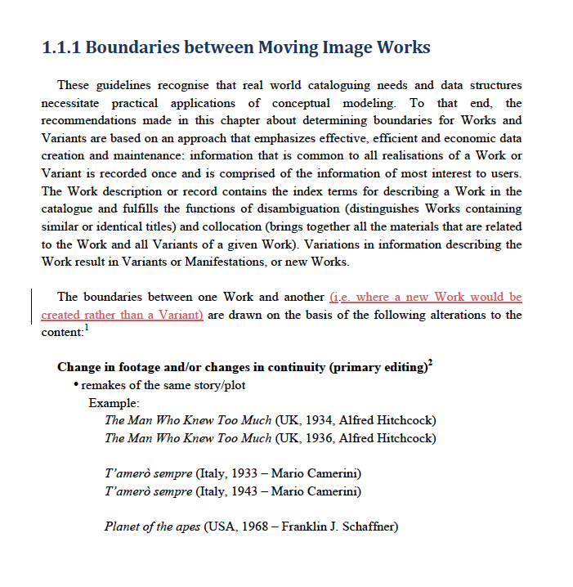
Notes:
The text includes liberal examples and appendices. Here is a sample page.

Slide 29
CONTENT STANDARDS
ARCHIVES AND MANUSCRIPTS
Rules for Archival Description (RAD)
Describing Archives: a content standard (DACS)
VISUAL MATERIALS
Cataloging Cultural Objects (CCO)
Notes:
Although I won’t be talking about them in detail, I did want to mention a couple of standards used heavily by paper archives and museums.

Slide 30
MAIN DIFFERENCES IN MOVING IMAGE CATALOGING
Titles
Versions
Preferred source of information
Physical Description
Notes:
Although there are many similarities between heavily used standards such as RDA, AMIM2, and FIAF, there are also significant differences that will influence how materials appear in catalogs and how researchers discover them. One of the main differences concerns how variant titles are treated. Especially with moving images, a piece might have a variety of titles -- original release title in country of origin; translated titles for any versions released in other languages; alternate or re-release titles; and so on. Many British films were released in the U.S. under different titles and vice versa for example. AMIM, FIAF and AACR2r all have different rules regarding titles. For example, with AMIM2 the main entry title would reflect the version in hand, with the original title if different included as a variant title. The original FIAF rules would use the original title for the main entry, even if that is not the title on the item in hand, while AACR2r will include a main entry for the version in hand, with the original title if different included as a uniform title and not an added entry. These differences will affect how records are collocated in different online databases, but also are influenced by how the particular repository manages their collections. The new FIAF manual, as well as CEN, differentiate between titles on works, manifestations, and items, and use the concept of title type to specify the title in question; this approach is better suited to the direction of cataloguing in the computer age.
Other differences between standards include how versions are described -- when a new record is made for a different version, say a subtitled print, a tv print, or a version on a different physical carrier, and where the data comes from.
Rules for recording physical description also varies between standards, with the more film-specific ones providing for more detail in this area and for multiple lines of description. This way, in a flat file system such as a MARC-based system, you can describe multiple elements or copies of a work on one record. For example, a particular library might have the same work on more than one format, such as a 35mm print, a VHS videocassette, and a DVD. Records in a hierarchical system are best suited to multiple physical descriptions for separate items.

Slide 31
How to choose content standards
Assess needs
Staff resources
Budget
Backwards compatibilty
“Fit” within institution/field
Notes:
Assess the needs/requirements of your materials and your users, ideally use the standard that is the best fit for your situation.
Take into consideration issues such as your resources for training; backwards compatibility (if the material will be aggregated with materials cataloged using a different standard in the past); and whether you will be merging your database with other resources (it is always helpful to use a standard widely used by others cataloging the same types of materials)

Slide 32
Making best use of content standards
Get training
Study rule interpretations
Library of Congress Rule Interpretations
Share records / experiences
Compendium of Moving Image Cataloging Practice
Notes:
Take advantage of resources as the LC Rule Interpretations and books on cataloging
View records created by others to use as samples, such as those published in the AMIA Compendium of Moving Image Cataloging Practice. Also, some softwares have cataloging rules built in, so they pop up when you click on a field.
You may need to modify rules to fit with your local practice, but do so carefully and selectively, so that you don’t jeopardize your ability to migrate data in the future.

Slide 33
Levels of cataloging
OCLC, FIAF, AMIM describe levels; institutions may interpret/define differently
RDA and new FIAF Manual suggest core and other elements rather than levels
PFA’s interpretation:
Inventory level: may be as brief as title, format/gauge, accession/classification number. Ideally, director, date, and country also noted.
Minimal level: title, alternate titles, director, production company, years of production and release, country of origin, physical description (medium, gauge, format, color, sound), running time, some technical and cast credits, accession number. Can be based on information from secondary sources.
Full level: moving image viewed completely, data taken directly from item, reference citations included, series title identified, summary note written, authority work for subjects and names, condition and preservation information noted.
Notes:
In addition to weighing factors in cataloging different types of material, most libraries and archives need to also address levels of cataloging. Most cataloging rules define different levels; I’ve listed PFA’s interpretations of cataloging levels above.
Although in an ideal world, we would all have the resources to catalog everything as fully as possible, this is rarely the case, so most libraries and archives have a triage system to assign various levels of cataloging to materials. At PFA, we generally create an inventory-level record when a work is first received, and later catalog it to a minimal or full level.
The nature of your institution and your collection will help determine what level or levels of cataloging you will strive for, and whether you will catalog different types of materials to different degrees. As most of us are faced with huge backlogs and meager resources, we need to plan cataloging workflow to provide the most access possible within a reasonable timeframe, weighing the needs of specific types of materials.
It is certainly optimal to create full records, transcribing information directly from item as well as using secondary sources. However, this process is very time-consuming = costly. Consequently, many institutions catalog to a less complete level, often from secondary sources of information.

Slide 34
Match standard to cataloging need and user need
Many U.S. film archives use RDA or AMIM2
Many European archives use FIAF
Historical societies, other institutions with varying types of archives may use APPM/DACS/RAD
Newer standards (RDA, DACS, new FIAF) may be more suited to a digital environment
Notes:
Make sure to include information on what standard you are using in your record.

Slide 35
Controlled vocabularies and authority control (value standards)
Established lists of controlled terms: some examples
Library of Congress Subject Headings (LCSH)
FIAF Subject Headings
Library of Congress Genre –Form Terms (LCGFT)
(supercedes Moving Image Genre-Form Guide (MIGFG)
Art and Architecture Thesaurus (AAT)
Library of Congress Authorities (authorities.loc.gov)
The Virtual International Authority File (VIAF)
Notes:
As we discussed last week, data value standards, or controlled vocabularies, are lists of names, titles or topical terms organized so that an indexer or cataloger can gather like items under the same subject. For example, one person might say moving images, another motion pictures, another film to mean the same thing. Without a controlled vocabulary, a researcher would not retrieve similar works indexed under different terms unless he or she searched under each individual term. The most useful controlled vocabularies are ones that are centrally maintained and contributed to centrally; in the U.S. the Library of Congress maintains several. And the Virtual International Authority File is compiling names from countries around the globe; it is maintained by OCLC.
Ones commonly used in film cataloging include the Library of Congress Subject Headings (LCSH) and Library of Congress Authorities. The Library of Congress Genre-Form Terms are merged with LCSH. VIAF aggregates Library of Congress authorities along with many from other countries.

Slide 36
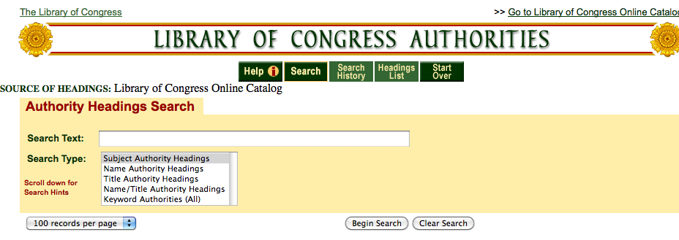
Authorities.loc.gov
Subject Headings
Genre/Form Headings
Name Headings
Title Headings
Notes:
The Library of Congress authorities website has aggregated subject, genre and form headings under “subject authority headings”; personal and corporate name headings, as well as title headings, are also collected here.

Slide 37
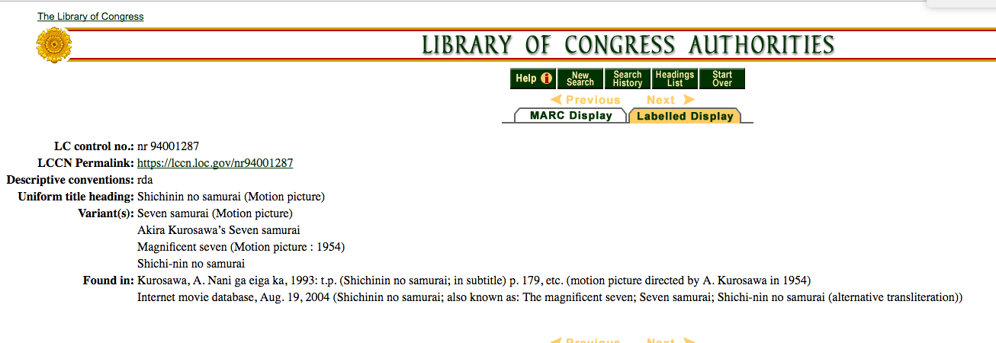
Title authority record
Notes:
Here’s an example of a Library of Congress title authority record for Seven Samurai showing a number of variant titles.

Slide 38
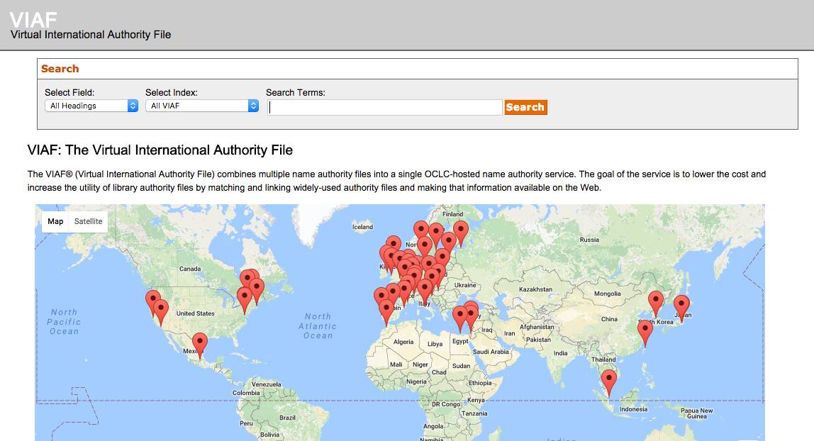
Virtual International Authority File
Notes:
The Virtual Authority File, which joins headings from a number of standards bodies from countries around the world, is maintained by OCLC. It includes headings for personal and corporate names, geographic name, and works, among others.

Slide 39
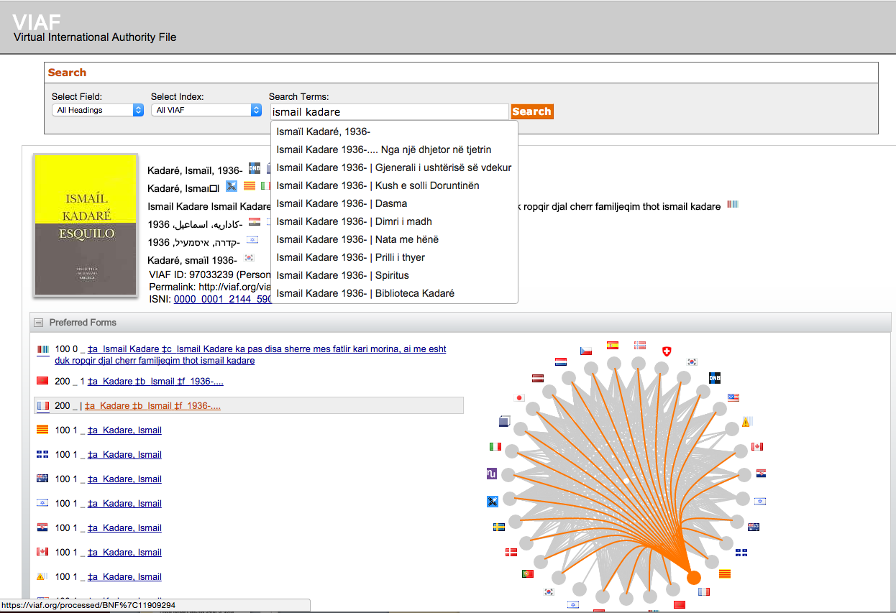
Notes:
Here is an example of a personal name record.

Slide 40
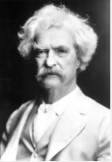

Can apply to
Personal names
Mark Twain
Samuel Clemens
Corporate names
Fox Film Corporation
Twentieth Century Pictures, Inc.
Twentieth Century-Fox Film Corporation
Notes:
Authority records enable one to link alternate, preceding, or succeeding names to one main term, then anyone searching by any alternate will still have a successful search.

Slide 41

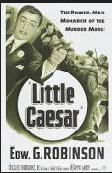
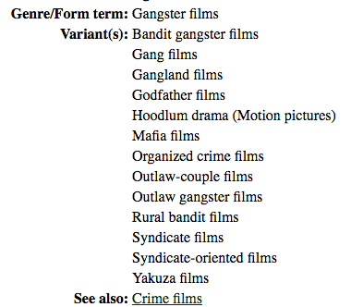
Can apply to:
Titles
Shichinin no ronin
Seven Samurai
Magnificent Seven
Topics (Subjects, Contexts, Genres)
Computers in films
Satire
Gangster films
Notes:
And they can not only describe a subject, but also put it in context

Slide 42

Differentiation
SYNONYMS
DENTURES
FALSE TEETH
Notes:
They can also differentiate between synonyms, or differently spelled words that mean the same thing, such as dentures or false teeth;

Slide 43
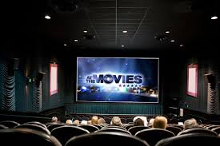
Differentiation
VARIANT SPELLINGS
Theater
Theatre

Slide 44
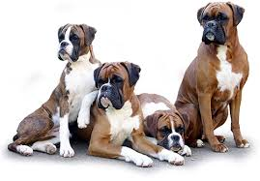
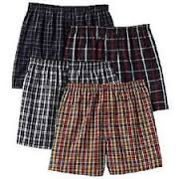
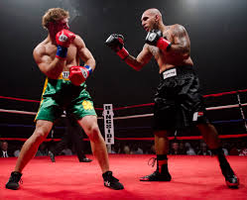
Differentiation
HOMOGRAPHS
Boxers
Notes:
Another key benefit of controlled vocabularies is that they can differentiate between
Homographs, or words spelled the same but with different meanings, such as boxers

Slide 45
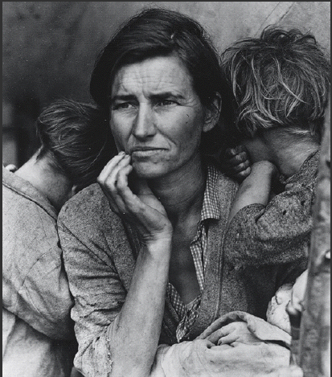
Notes:
Indexing images brings additional complexities, in that you may not only need to describe the content of the image - what is actually represented -- as well as what the image is about.
And, someone looking for images depicting rural poverty or migrant labor would only find Dorothea Lange’s photographs if they were indexed using these concepts. I should say that I did find this image via Google using the search terms “rural poverty”, so the underlying indexing was very precise.

Slide 46
Factors In Cataloging Various Types Of Moving Images
Features Documentaries
newsreels
Avant-Garde works
STOCK FOOTAGE
Home MOvies
Notes:
I’ll now go over some additional factors that moving image catalogers must consider. In-depth film cataloging can take much more time than cataloging other formats, so libraries need to weigh the special cataloging needs of various types of materials and factor that in to the time alloted for cataloging.
Although copy cataloging can certainly help reduce cataloging time, not all films, especially the rare or obscure works found in film archives, have records in utilities like OCLC. Even if a record exists for one format, a cataloger needs to make a new record for each different edition or physical format, just like you would create a new record for a different edition of a book or version on a different carrier, say a book on tape. Some of this duplication may be avoided when future catalogs move to a FRBR model.

Slide 47

Features
Easiest to find information
on item in secondary sources
Newer releases have voluminous credits that can exceed record field lengths
Subject and genre access less of a priority because information is readily available elsewhere.
Notes:
Feature films are usually the easiest kind of moving image to catalog, as there is lots of information about them on the Internet and in databases. Additionally, many will be in utilities like OCLC. However, the voluminous amount of information means that full level catalog records can be very time consuming to create and enter, and may not be the best use of a cataloger’s time. But limiting the amount of information available in catalog records will impact retrieval.

Slide 48
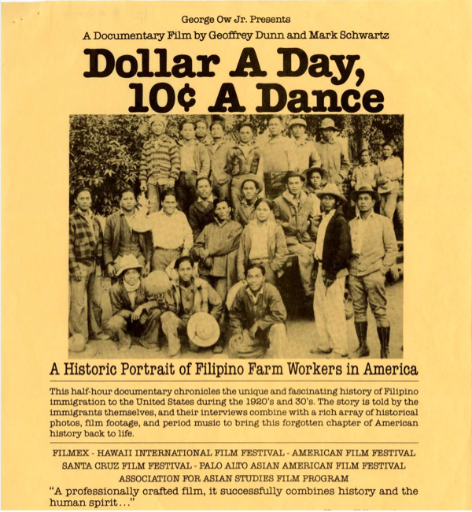
Documentaries
fewer secondary
sources of information
subject index crucial;
must consider level of detail
shot-level description useful
but time-consuming
Notes:
Subject access is much more important when cataloguing documentaries, as they are usually retrieved by subject. Indexing beyond the general subject, to include details on specific shots (shot-level indexing) can be of great value to historical research – for example noting shots of particular buildings or people. However, the very high cost of indexing to shot level must be balanced within institutional resources. Also, the level of detail can really make a difference here. For example, a shot of a bridge just tagged as "bridge" is a lot less meaningful than if it was labeled "Golden Gate Bridge.”

Slide 49
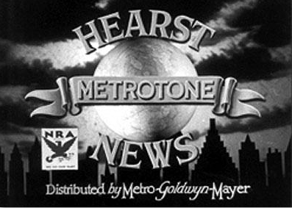
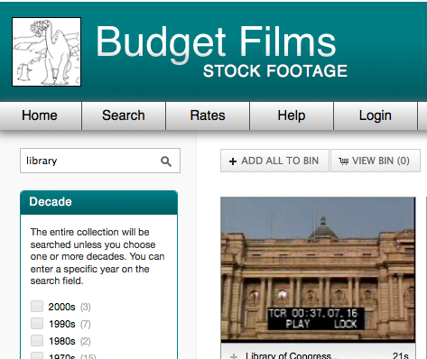
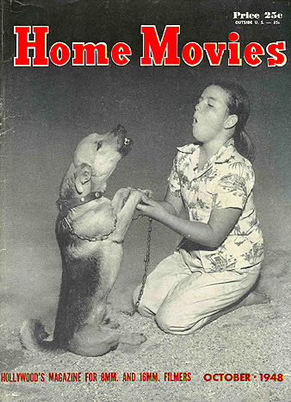
Newsreels, stock footage, home movies
little to no secondary
sources of information
Titles and other information
Often supplied by cataloger
Summary notes and index terms very helpful
Notes:
Newsreels and stock footage are generally harder to catalog since there is little or no information available on the item itself. Newsreels, like television, have multiple titles, parts, and series titles, whereas stock footage generally doesn't have much, if any, credit or title information on the item so the cataloger must supply all the information. In-house vocabularies are often used for such collections, as they can provide more precise and colloquial access than standard headings like LCSH.
Another type of material with unique characteristics is amateur film, or home movies. Unless the filmmaker is someone like my dad, who even in the 1960s liked to insert titles in our family’s home movies, usually such films have no titles so the cataloger must supply them. The title can briefly describe the item (example: [Vacation in Italy – Lucille Ball – home movies]. Most cataloging rules suggest that supplied titles should be enclosed in square brackets, which indicates that the information was not actually found on the item. Here, as with many non-standard genres, summary notes describing the contents of the work are extremely useful.

Slide 50
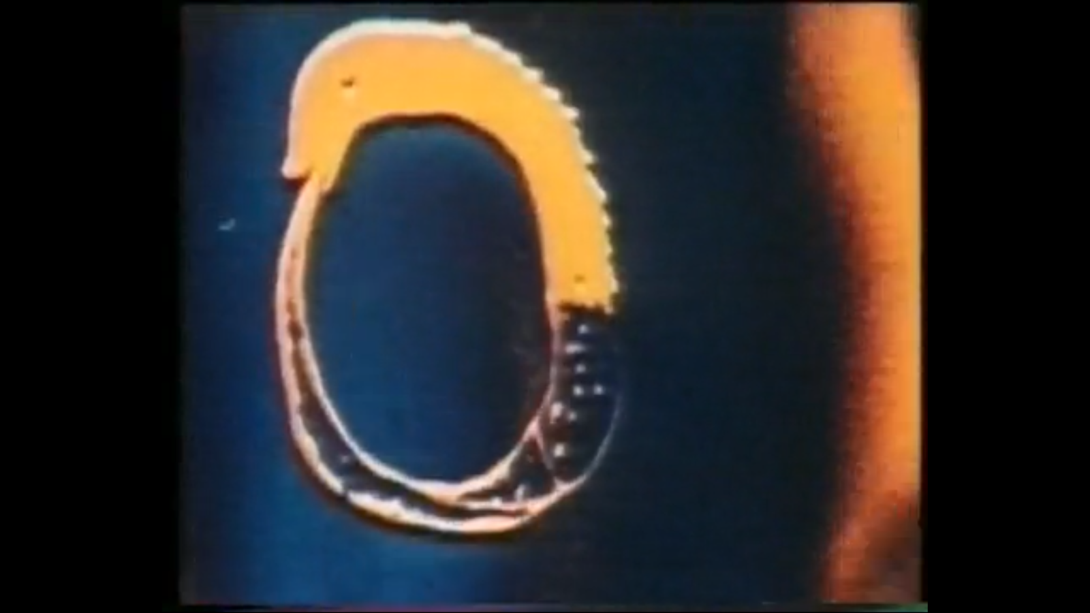
Avant-garde works
James Whitney, Lapis (1966)
little to no secondary
sources of information
difficult to ascertain
version and/or
completeness
in-depth subject and
genre access crucial
Notes:
In cataloguing avant-garde works, catalogers frequently need to use secondary information sources to flesh out a record, and in-depth knowledge of this type of film can be a great asset. For example, filmmaker James Whitney’s works don’t credit him on the screen. But they contain an Ouroboros (an ancient symbol depicting a snake or dragon eating its own tail) at the beginning and ending of each of the films. So unless a cataloger is familiar with his work they would have to do some research to accurately identify a film by him. In addition, for more obscure films it can be quite difficult to find any information at all. Avant-garde filmmakers, like many artists, also have a tendency to make multiple versions of a work, creating another challenge for cataloguing. And to provide in-depth subject or genre access to such works may require in-house vocabularies, as general ones may not offer adequate terminology.

Slide 51
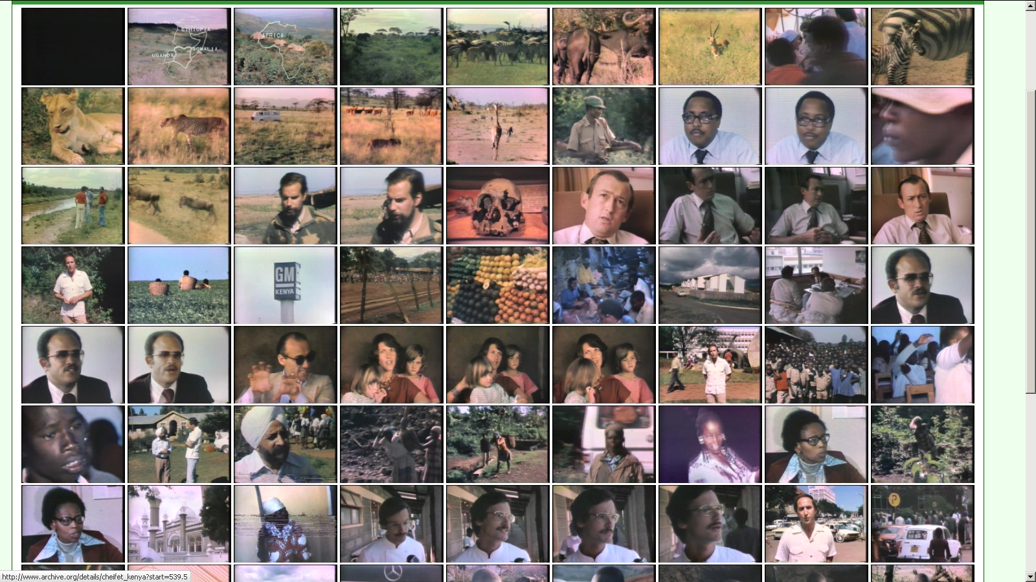
Shot-level indexing
Eye in the African Storm (1979)
little to no secondary
sources of information,
except for possibly
shooting logs
especially labor intensive
essential for licensing
stock/news footage
Notes:
Shot-level indexing is essential for libraries licensing stock or news footage but extremely labor intensive. Sometimes secondary sources of information, such as shooting logs, can supplement indexing.

Slide 52
Collection level
Used to catalog multiple works collectively in one record
Some examples
Home movies from one family
Commercials from same creator
Multiple nights of same performance
Notes:
Another useful tool that is used frequently in cataloging paper archives as well as moving images is the collection-level record. It can save a lot of time and help an institution get basic control over a collection more quickly. Some materials can remain long-term with a collection-level description, while others are eventually re-cataloged at an item level.

Slide 53

The ideal
Create full catalog record for each item
Transcribe information directly from item
Supplement information with secondary sources
Notes:
I’ve listed above what I think most cataloguing departments would love to be able to do. Unfortunately, limited resources rarely allow for full cataloguing all the time.

Slide 54

The real world
Often can’t view item being catalogued
Cataloguing from secondary sources – published works, distributor catalogs, other catalog records – sometimes results in attributing incorrect filmographic information to item
Strive for a balance – catalog obvious works from secondary sources and view more complicated works (at least for head and tail credits)
Notes:
Consequently, here are guidelines that more closely approximate what usually happens in a moving image cataloguing department.

Slide 55
Acknowledgments
Many thanks to Thelma Ross, Moving Image Cataloger at the Museum of Modern Art, and to Andrea Leigh, Moving Image Processing Unit Head at the Library of Congress, Motion Picture, Broadcasting and Recorded Sound division, for some of the graphics used in this presentation.

